Slide 1
Final Presentation-Hapit
Team Sprite

Slide 2
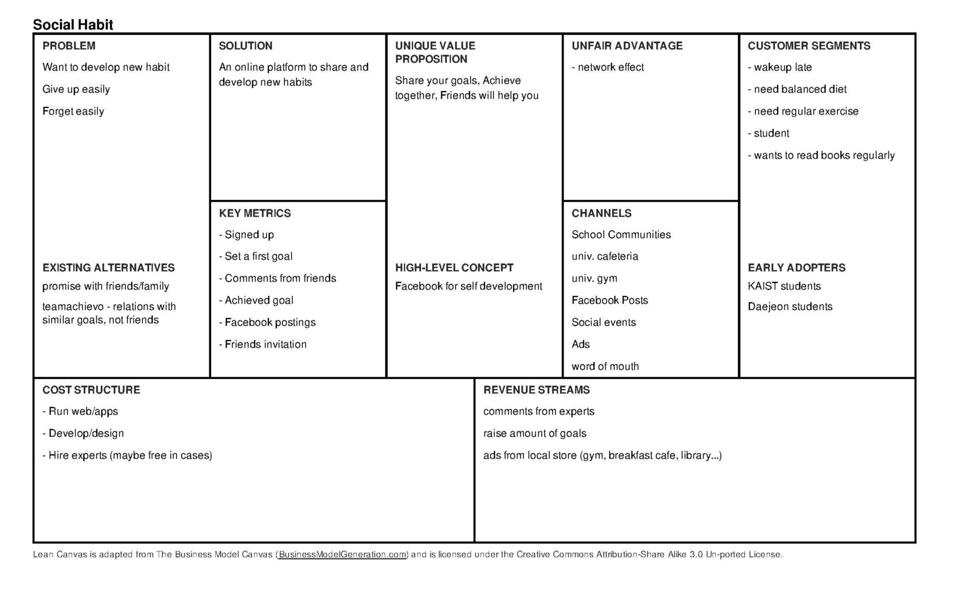

Slide 3
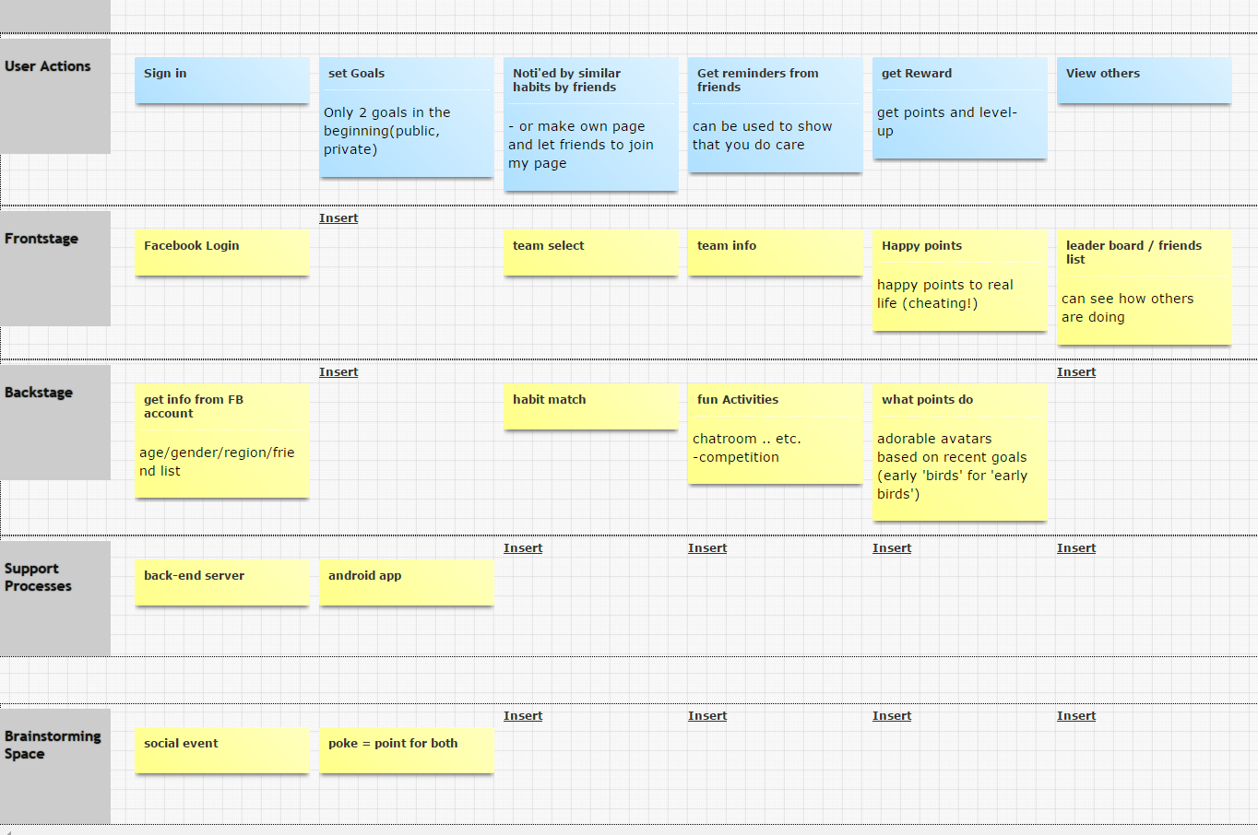

Slide 4
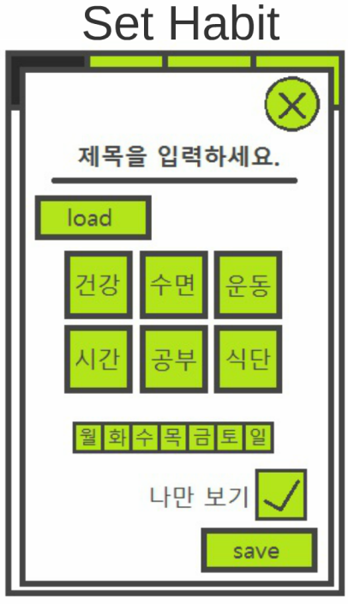
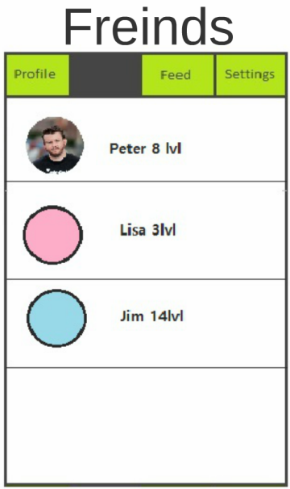
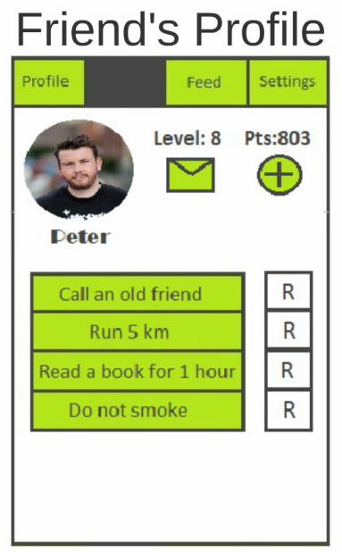
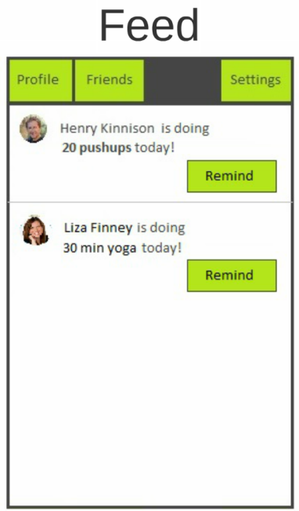
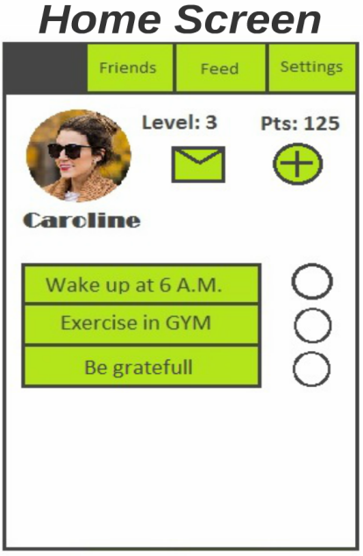
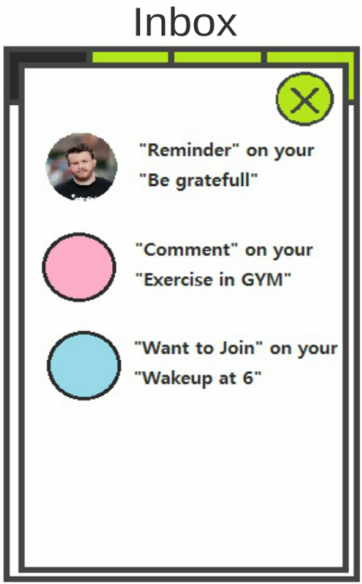

Slide 5
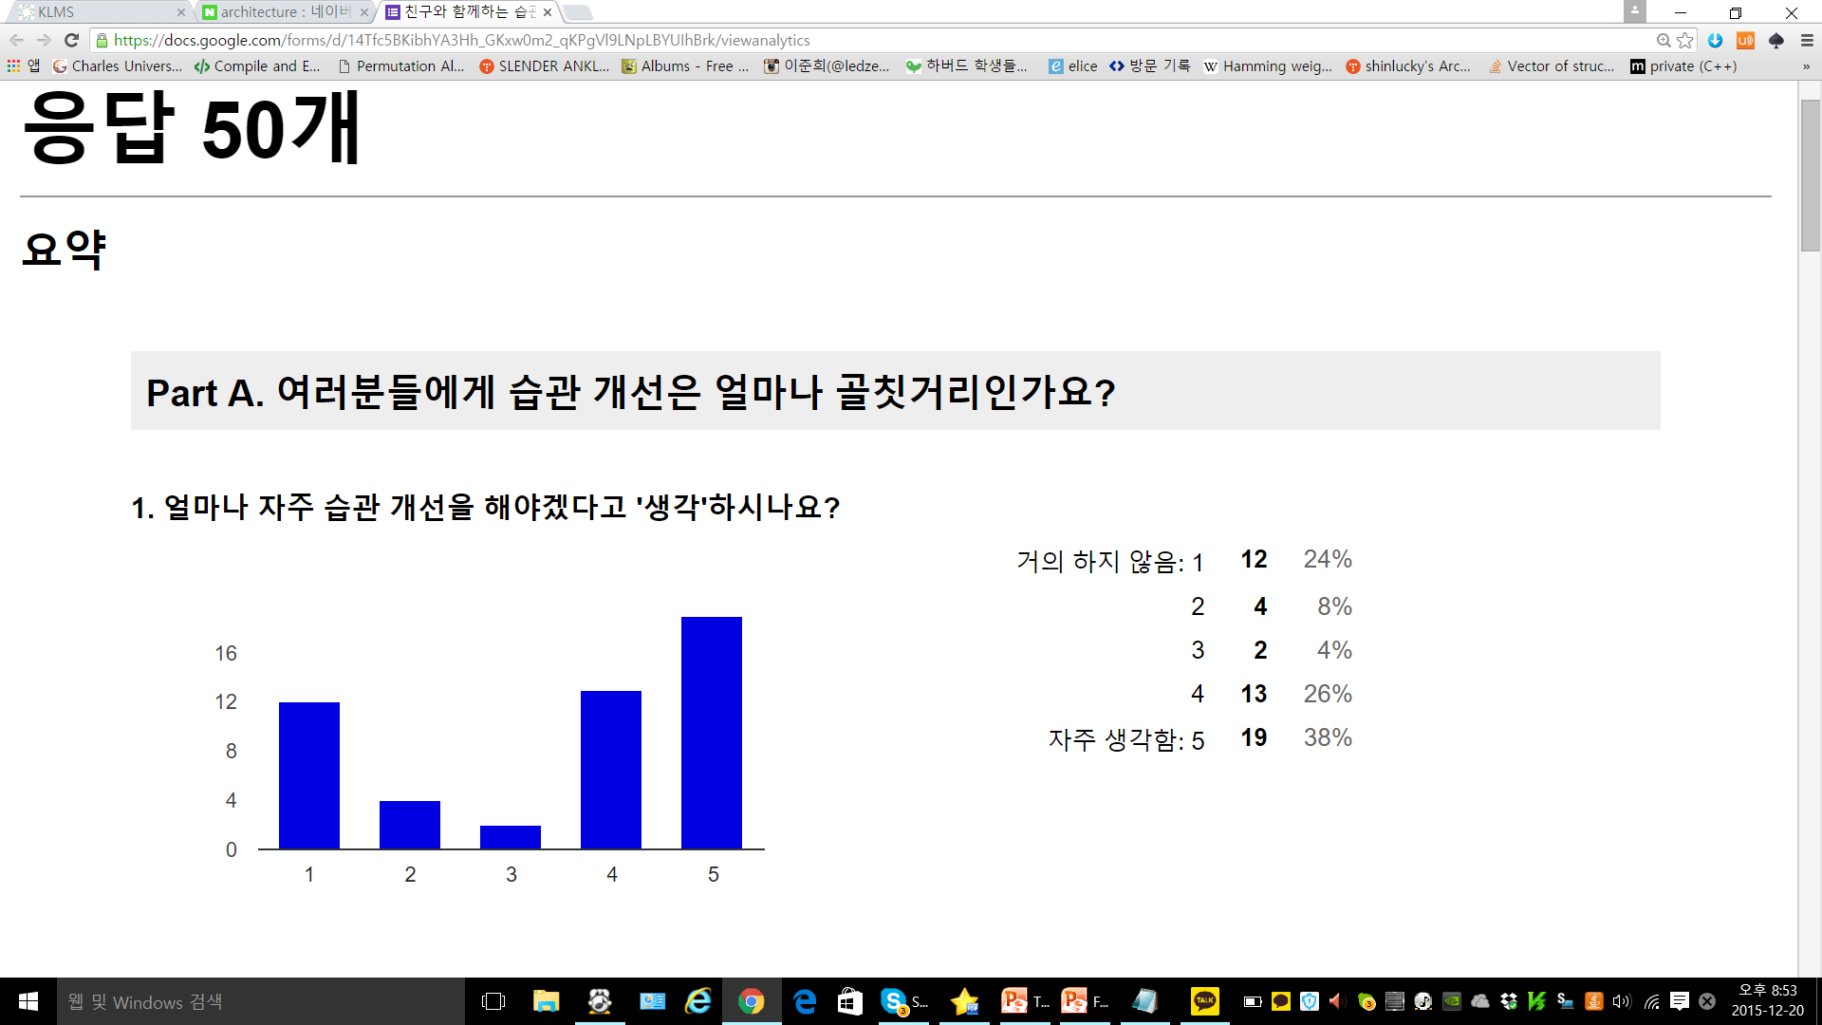
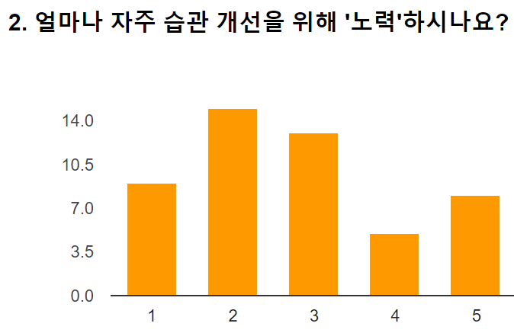
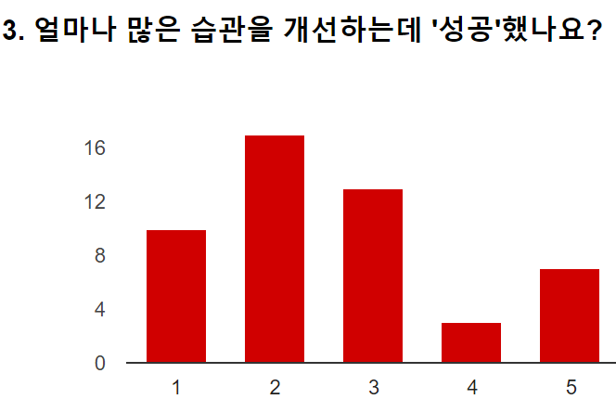
Problem Fitness Evaluation Result(50명)
More often
More often
More often

Slide 6
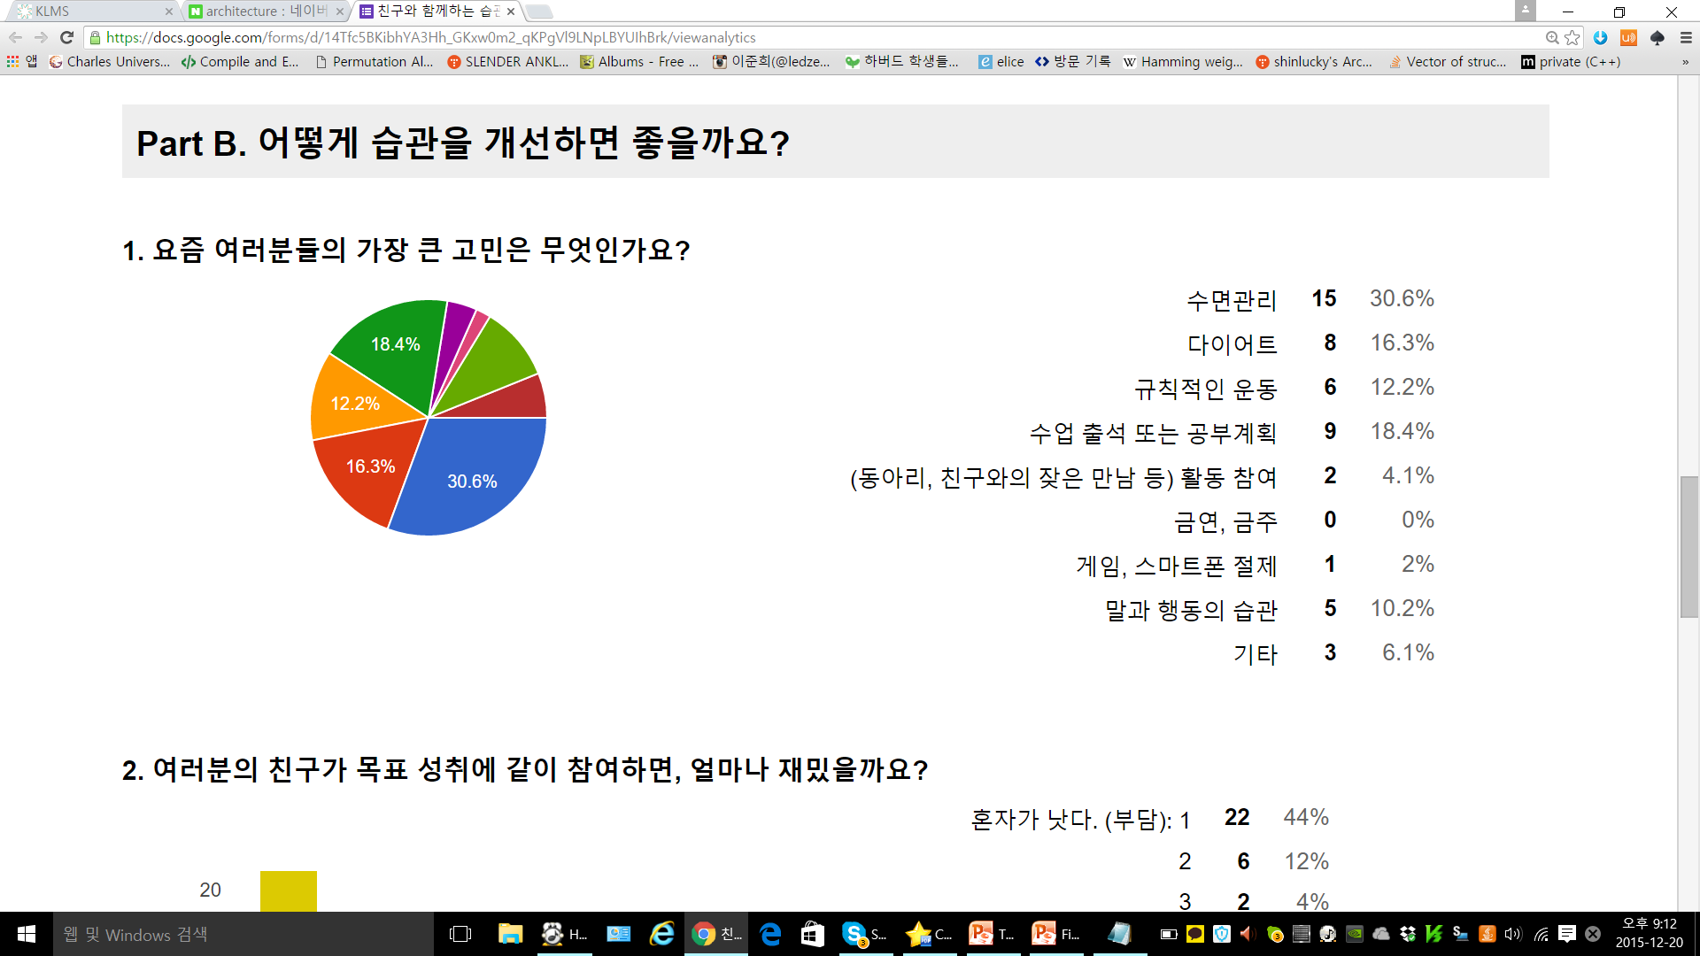
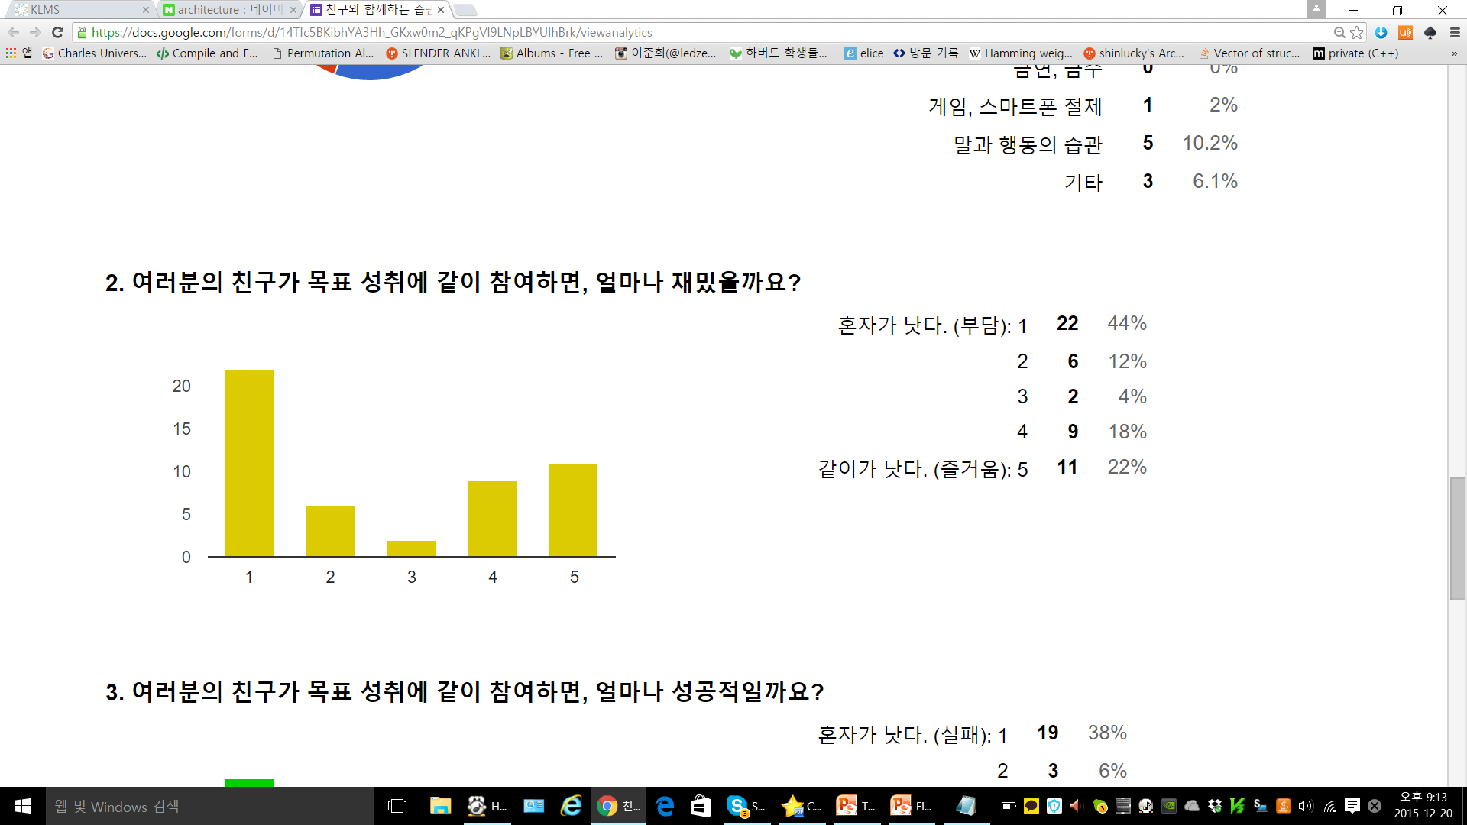
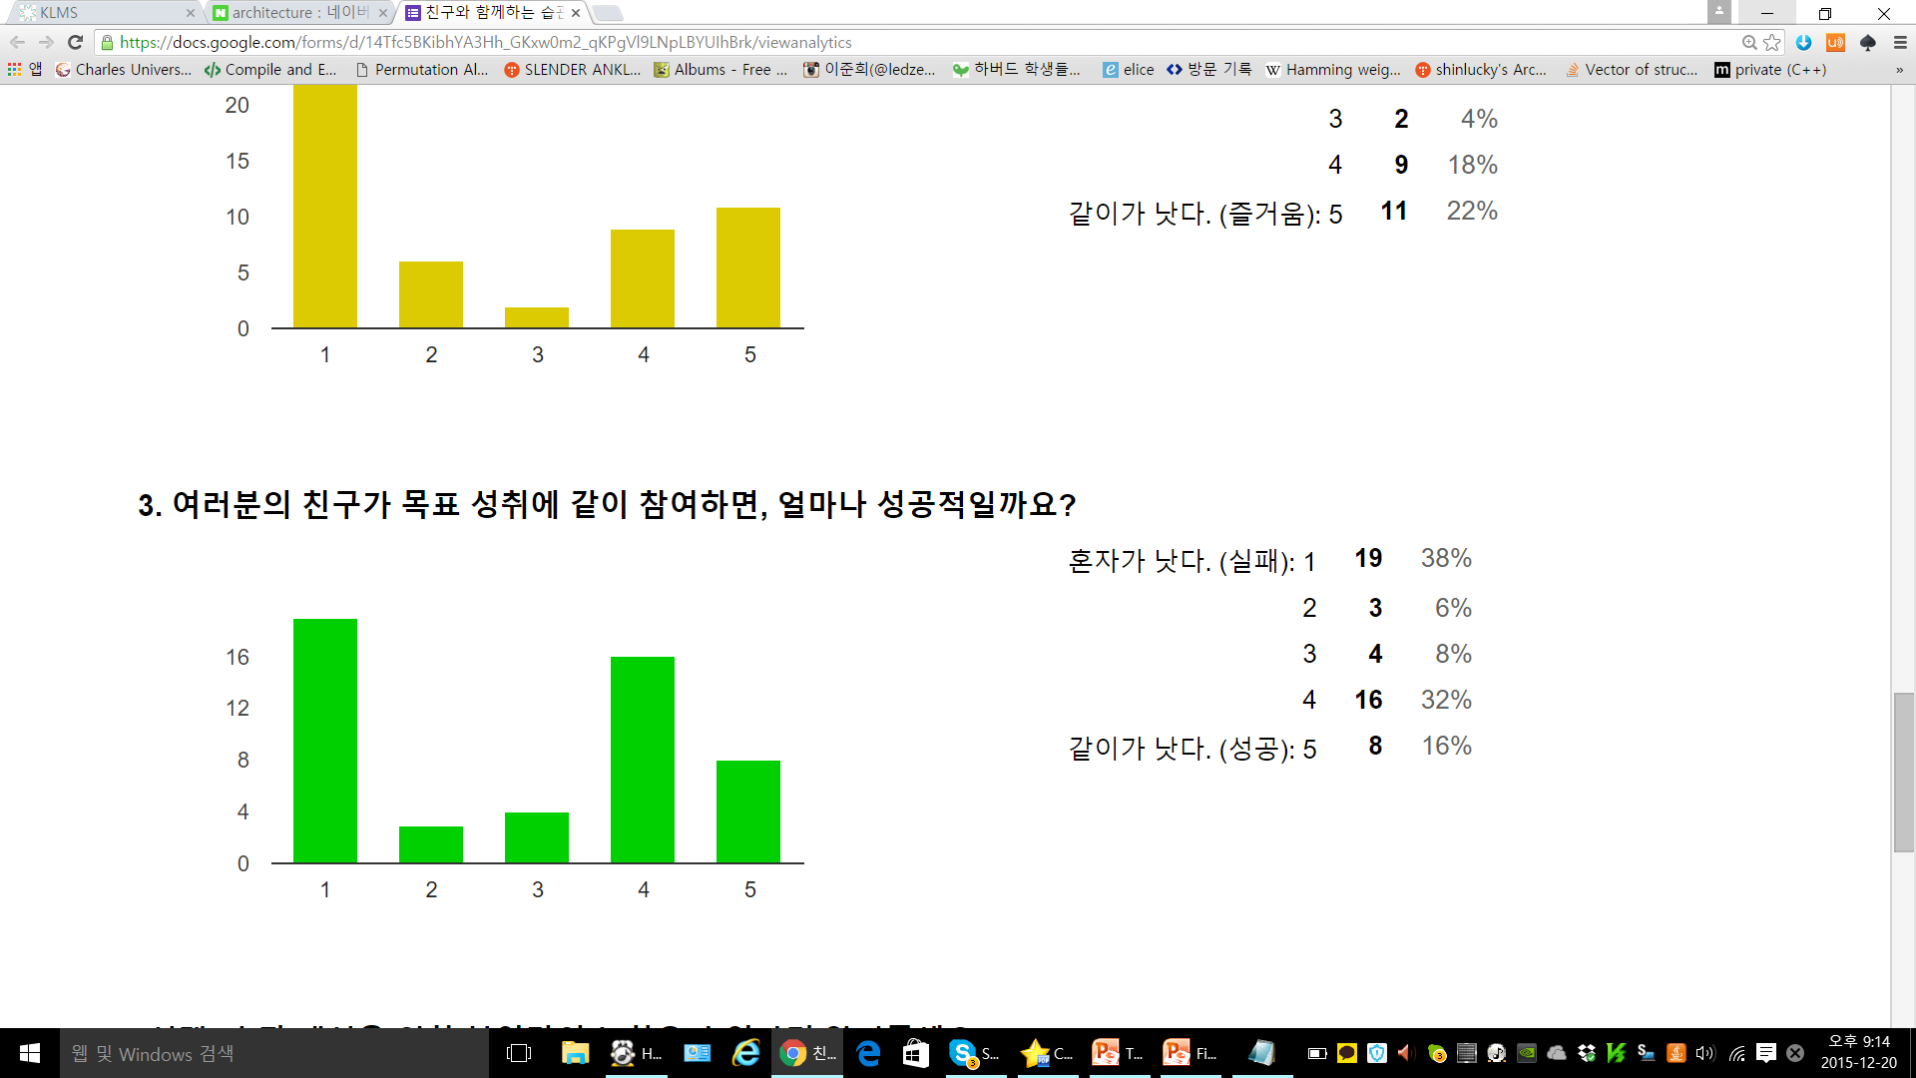
Solution Fitness Evaluation Results(50명)
More fun
More successful

Slide 7
System
MainActivity
-Tablistner
-3 Fragements(Tab)
[Habit inner Class]
-Adaptor(Print)
-user-to-user push alarm(Parse.com)

Slide 8
Summary of App
By this Application,
People make new “Hapit Share Community”,
It’s induced that positive behaviors of people.

Slide 9
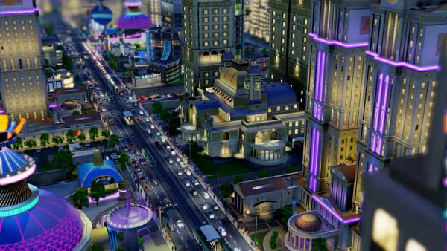
Virtual Reality
Notes:
우리가흔히생각하는 게임에서는 사냥과 캐릭터의 성장을 목적으로 해서 길드시스템도 만들어지고 사람들이 모이고모여서 커뮤니티를 구축하여 사람들간의 의사소통으로 행복을느낀다. 그래서 마치 그런 게임들처럼, 목적만 완벽한 Habit형성으로 긍정적인 사회를 만드는것에 기여하는 게임을 만들고싶다.
In common games, the object is hunting and growth of their characters. So to get it more effiecient, people meets people and they make guild system and finally they feel happy by having communication with people. So like that games, By changing the object making perfect formation of habit, we wanna make game that contribute more positive society.

Slide 10
Hapit
Application makes
People share positive habits frankly, So
It induce positive society
Truly.

